Slide 1
User design
NeedFINDING
Target audience: lunch go-ers (student/faculty)
Maga, katrina kin
Lapuz, Karlvin

Slide 2
Questions:
What are your thoughts on the allotted time for lunch breaks, is it enough?
How do you spend your breaks?
Are the food choices on the cafeteria enough?
How about the food line queuing?
What are the reasons for you not to eat at the cafeteria, and where do you usually eat out?

Slide 3
Interviewee: Yukimura Rin Age: 19
What are your thoughts on the allotted time for lunch breaks, is it enough?
It's enough to eat and chill with friends.
How do you spend your breaks?
I spend it bugging my friends.
Are the food choices on the cafeteria enough?
They're enough
How about the food line queuing?
The queue can be too annoying. hopefully APC changes or adjusts some courses and sections time for lunch.

Slide 4
interviewee: Jasper Canale Age: 25
What are your thoughts on the allotted time for lunch breaks, is it enough?
More than enough than you can imagine. Although college's lunch time is always clashing with the Senior High's.
How do you spend your breaks?
Eating lunch, freshening up myself to the Comfort room and rest.
Are the food choices on the cafeteria enough?
Not much variety, it's weekly menu change which is kind of boring and not good.
How about the food line queuing?
Line it's not too long since most of the students tend to eat outside rather inside the campus.
Do you eat your lunch in caf? If not, where?
Eating at dorm/apartment then call for take-outs but that's really rare occurence.

Slide 5
Interviewee: Conway Frost Age: 19
What are your thoughts on the allotted time for lunch breaks, is it enough?
My thoughts on the time given for lunch doesn't help considering that the cafeteria becomes full and hard to find tables to eat at and really long lines as well as it doesn't give enough time to eat outside. If you are able to wait till the crowd in the cafeteria decreases it doesn't give enough time to sit down and eat because you only have a few minutes.
How do you spend your breaks?
Getting a few minutes of rest in the library then going to get lunch in the cafeteria.
Are the food choices on the cafeteria enough?
The food choices are plenty.

Slide 6
Interviewee: Conway Frost Age: 19
How about the food line queuing?
The line queues are very long and you're lucky to be able to reach the counter and find a table
Do you eat your lunch in caf? If not, where?
Yes I eat lunch at the cafeteria but when it is too crowded I just eat at the convenient store outside

Slide 7
Interviewee: lio scarboro Age: 20
What are your thoughts on the allotted time for lunch breaks, is it enough?
It is not enough if you consider the time it takes for students to line up and order food in the cafeteria. If one brings packed lunch, then, this is a non-issue and the time would be enough for one to finish lunch.
How do you spend your breaks?
I spend my breaks eating, reviewing, and playing games.
Are the food choices on the cafeteria enough?
The food choices in the cafeteria are enough for the average consumer. Rice meals, Filipino Meals, and Pasta with bread and milk tea. However, for those who are looking for burgers and other such things, perhaps select and Jollibee might be a better place and that resides outside the school at the Gas Station that is Shell. If these still do not suit the palate of the student, it would be a far longer walk to the nearest food place away from the school itself.

Slide 8
Interviewee: lio scarboro Age: 20
How about the food line queuing?
I feel like the lines are indeed too long and this attributed to the lunch hours being too short or at the same time as other classes. Either increase the time allotted to lunch hours or schedule the lunch hours for each set of classes better.
Do you eat your lunch in caf? If not, where?
No, I eat my lunch in the Library because it's a lot more quiet and calm than the cafeteria.

Slide 9
Interviewee: Ranz Martinez Age: 19
What are your thoughts on the allotted time for lunch breaks, is it enough?
its more than enough, taking meal and doing academic related stuff
How do you spend your breaks?
eating lunch with friends and doing schoolworks
Are the food choices on the cafeteria enough?
Yes, there's a lot of food choices you can go to
How about the food line queuing?
sometimes it took to long because of too much customers while there are 1 to 2 staffs at the counter to serve them
What are the reasons for you not to eat at the cafeteria, and where do you usually eat out?
It is crowded when its breaktime and mang danny's eatery is much afforadable

Slide 10
User needs:
Enough time for breaks
Food line queueing
Variety of food
Volume of students (Lunch Goers) should be taken to consideration in regards of cafeteria availability
Why students choose to eat out of the campus

Slide 11
Point of view:
Based on our interviewed people’s responses. Their lunch time is more than enough however the time with the other classes like example Senior Highschool’s break time tend to interrupt their own break time and caused them to queue more students in the line. Then in that case, they tend to leave the campus to eat somewhere outside since or some will not eat lunch and just hang out with their friends.

Slide 12
Point of view:
Crowded cafeteria, we need to split the lunch break time
Boring foods menu, constant change of food menu in the cafeteria
Expensive food, put “Budget-meals” on the menu
No seats available, add more tables and seats for everyone

Slide 13
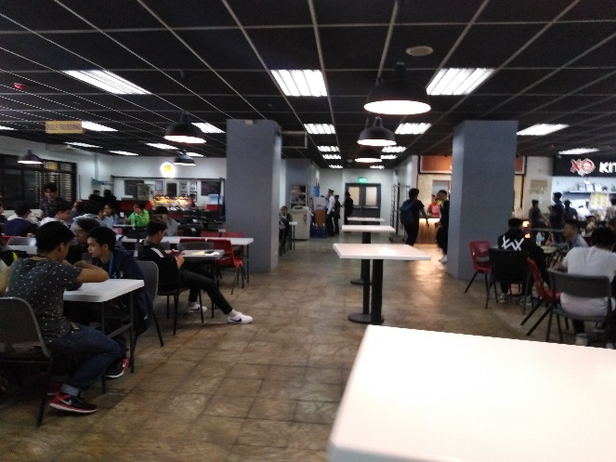
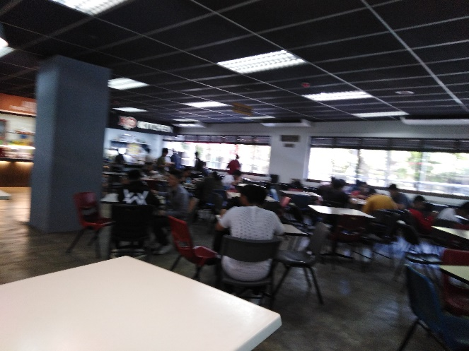
documentation:

Slide 14
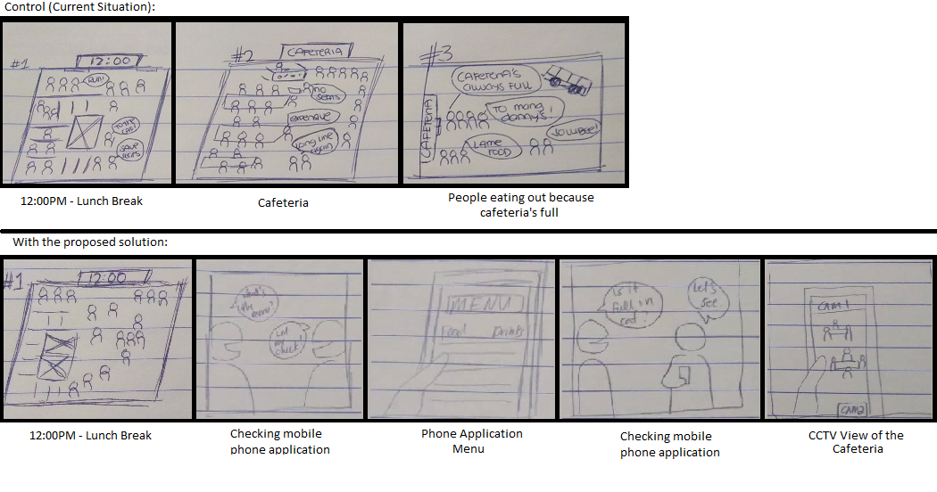
Storyboards:

Slide 15
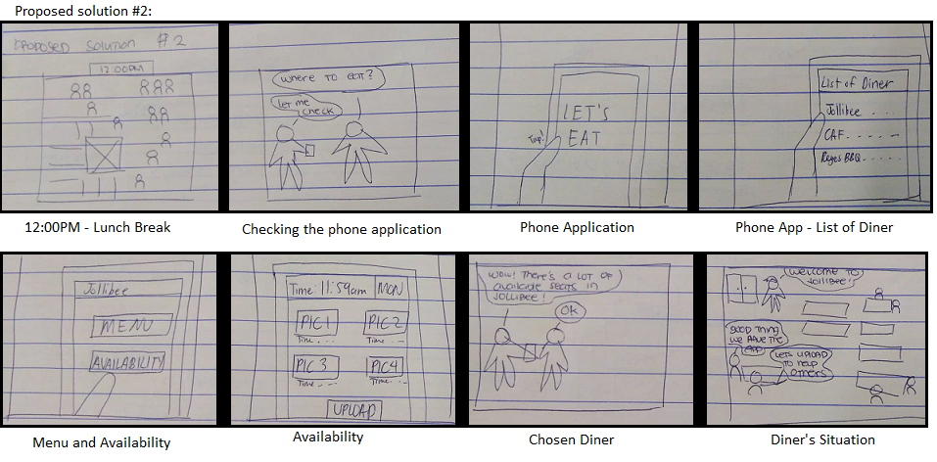
Storyboards:

Slide 16
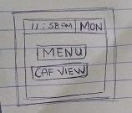
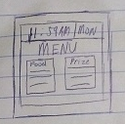
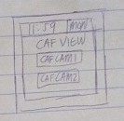
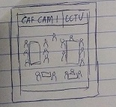
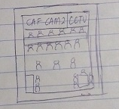
Prototype#1

Slide 17
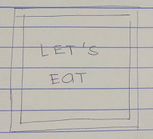
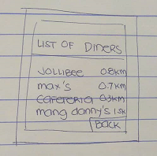
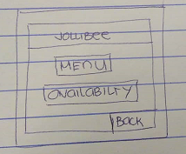
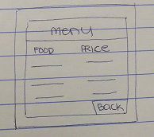
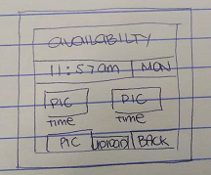
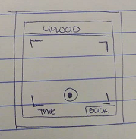
Prototype#2

Slide 18
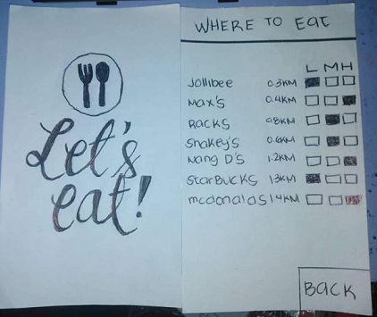
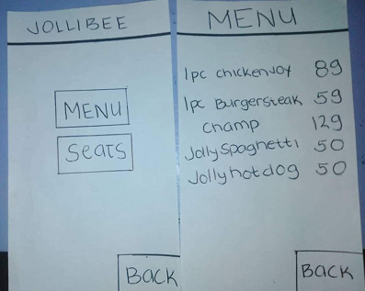
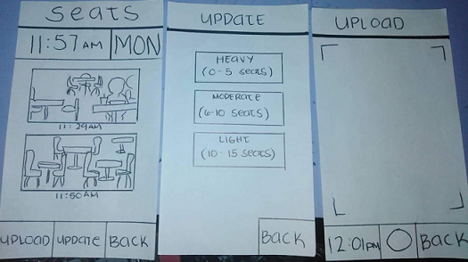
Prototype#2

Slide 19
Video references:
https://www.youtube.com/watch?v=g4hGXjYXlYI&feature=youtu.be&fbclid=IwAR38e2U-cNO5d2vUHN7wOEUz0ln6IrjtFMGr1cEQM90Z-fsaQGeJBF7fStw
https://www.youtube.com/watch?v=rIkB1o9cJpM&feature=youtu.be&fbclid=IwAR3-rl3Ku8WJxcPf2vgCtQV4EOSdUglzFfm9rx10ebHtQV1lAz3pD9zs07U

